Slide 1
Lesson 3.16
Internal Communication Requirements
CGPRT(W) : Ensuring Clean Seas and Coasts in Western Region ……

Slide 2
Objective
To understand the need for an internal communications plan.
CGPRT(W) : Ensuring Clean Seas and Coasts in Western Region ……

Slide 3
Two Plans
Communications plan
  Response team
  Response community
  Senior administrators/Ministers
  Regional and international contacts
Media relations plan
Media
Public
CGPRT(W) : Ensuring Clean Seas and Coasts in Western Region ……

Slide 4
Internal Challenges
Vertical flow of information challenges:
Capturing, analysing and reporting the information in a timely manner
  aerial surveillance
    fixed wing, rotary, satellite, unmanned
  offshore units
    response vessels, other marine traffic
  onshore units
    response sites
CGPRT(W) : Ensuring Clean Seas and Coasts in Western Region ……

Slide 5
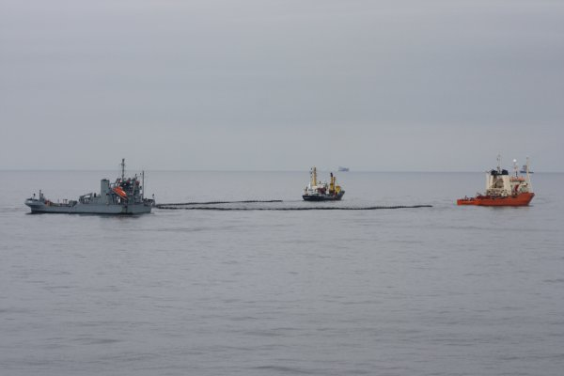
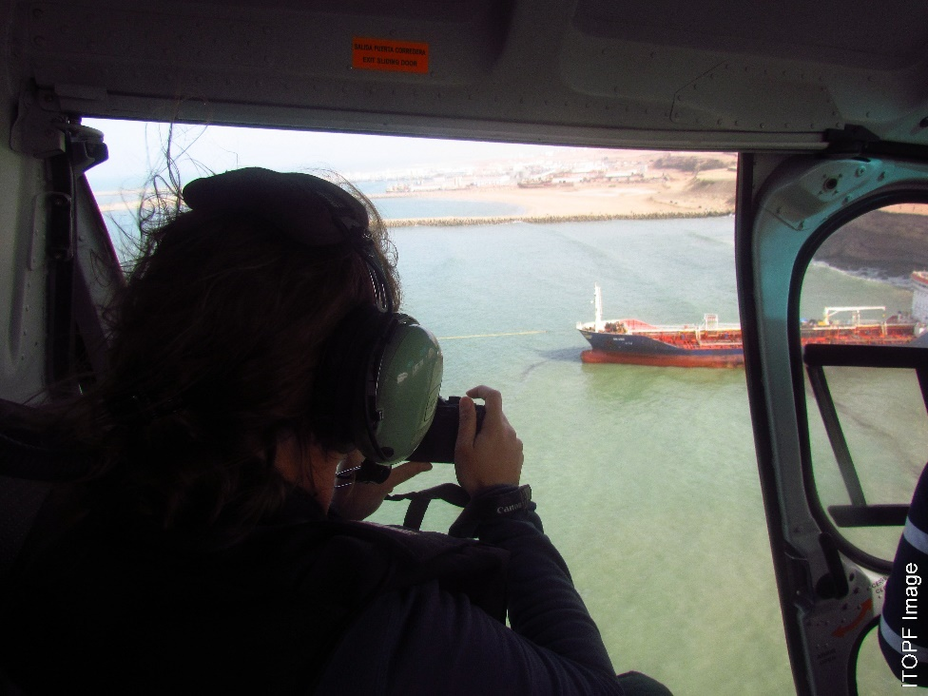
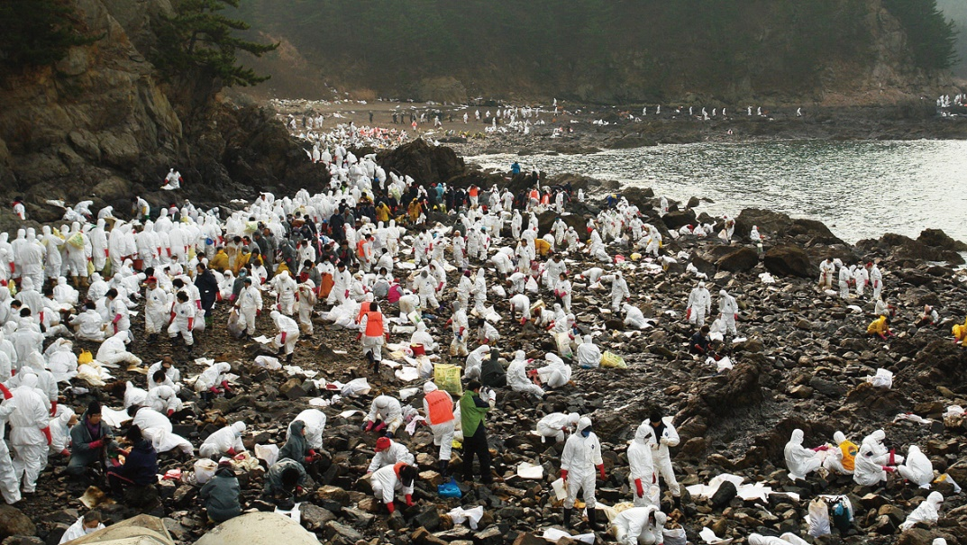
Internal Challenges
CGPRT(W) : Ensuring Clean Seas and Coasts in Western Region ……

Slide 6
Internal Challenges
Vertical flow of information challenges:
Numerous organizations
  lack of familiarity and teamwork
  differing reporting formats and mediums
  differing terminology
Numerous locations
  separate response management locations
  overloaded carriers, crowded airwaves
  poor or no reception
CGPRT(W) : Ensuring Clean Seas and Coasts in Western Region ……

Slide 7
Communications
Satellite communications (SATCOM)
  Ship to ship
  Ship to shore
  Ship to aircraft (specialized)
  Data
  Fax
  Long range
  Relatively secure
CGPRT(W) : Ensuring Clean Seas and Coasts in Western Region ……

Slide 8
Communications
Radio telephony
  Ship to ship
  Ship to shore
  Ship to aircraft (specialized)
  Effective in transmitting to all stations within reception area
  Medium to long range
  Not secure
CGPRT(W) : Ensuring Clean Seas and Coasts in Western Region ……

Slide 9
Communications
Very High Frequency (VHF)
  Ship to ship
  Ship to shore
  Ship to aircraft (specialized)
  Medium (shore station) to short range
  Effective in transmitting to all stations within reception area
  Response units may have private frequencies
  Not secure
CGPRT(W) : Ensuring Clean Seas and Coasts in Western Region ……

Slide 10
Communications
Ultra-High Frequency (UHF)
  Ship to air
  Air to air
  Ground to air
  Team to team
  Short range
  Response units may have private frequencies
  Not secure
CGPRT(W) : Ensuring Clean Seas and Coasts in Western Region ……

Slide 11
Communications
Cellphones, etc
digital cellphones, Personal Digital Assistants (PDA), laptops
access to internet
digital forms, photographs
time stamp
generally not explosion-proof or intrinsically safe
All communications need power supply
CGPRT(W) : Ensuring Clean Seas and Coasts in Western Region ……

Slide 12
Storage of Communications
Capture and storage of data
system to capture data
system to store data
system to analyse data
system to sift information, remove salient facts and re-transmit
needs to be as near to “real-time” as possible
out of date information has limited use
CGPRT(W) : Ensuring Clean Seas and Coasts in Western Region ……

Slide 13
Manage Communications
How do we manage our communication needs?
prepare a communications plan
harness technology
think ahead
study and learn from other countries
have sufficient resources
exercise your plan
assess lessons
update plan to incorporate lessons
CGPRT(W) : Ensuring Clean Seas and Coasts in Western Region ……

Slide 14
Incident communications network
Command Zone
Incident Zone
Response Zone
Support
Vessel
Clean Up Team
HQ
UHF / VHF
H
Communications
Satellite
R
H
Aerial
Support
Team
Supervisor
H
Landline
H
UHF / VHF
H
Marine VHF
Telephone
Telex
Fax
Control
UHF / VHF / HF
Oil Spill
Command Centre
R
H
H
Inmarsat
Team
Supervisor
H
Clean Up Team
Communications
Trailer
Cellnet
UHF / VHF
H
R
Generator
H
H
Other
Organizations
Battery
Team
Supervisor
R = Repeater
H = Hand Held Radio
H
Generator
Clean Up Team
CGPRT(W) : Ensuring Clean Seas and Coasts in Western Region ……

Slide 15
Vertical Reporting
Vertical reporting
  the flow of information up and down the command structure of the incident
Incident Command Centre:
to incident response teams and units
to senior government bodies
to other national stakeholders
to bilateral and regional neighbours
to the international community (via IMO?)
CGPRT(W) : Ensuring Clean Seas and Coasts in Western Region ……

Slide 16
Vertical Reporting
Types of reports
Field situation reports (offshore)
  search and rescue
  salvage
  cargo transfer
  surveillance and reconnaissance
  dispersant spraying and monitoring
  marine recovery
  In situ burning
CGPRT(W) : Ensuring Clean Seas and Coasts in Western Region ……

Slide 17
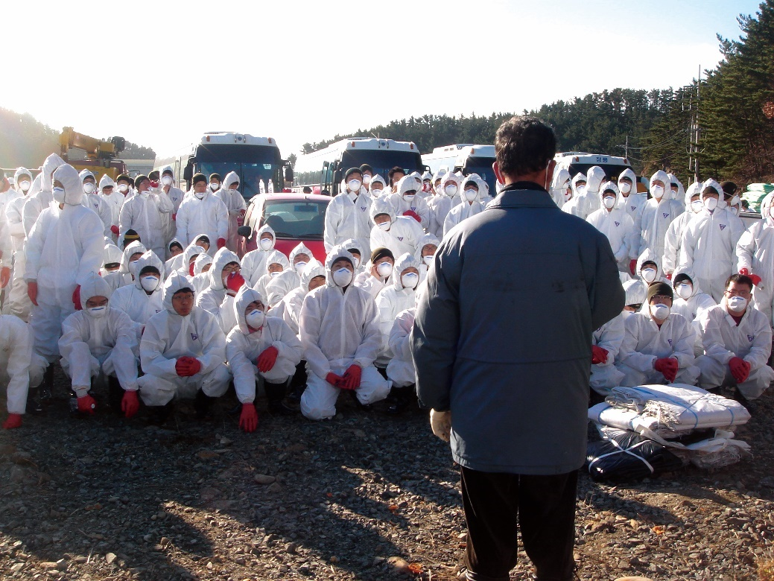
Vertical Reporting
Types of reports
Field situation reports
  SCAT
  shoreline protection
  shoreline response
CGPRT(W) : Ensuring Clean Seas and Coasts in Western Region ……

Slide 18
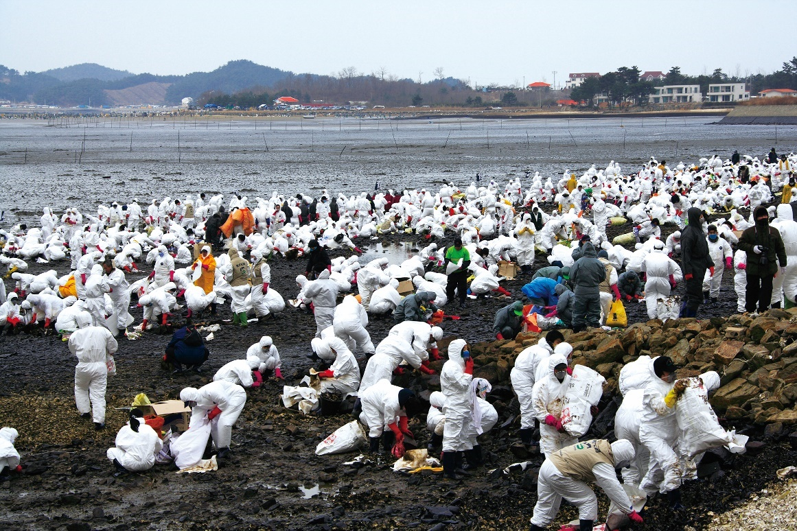
Vertical Reporting
Types of reports
Field situation reports
  waste handling
  health, safety and welfare
  logistics
CGPRT(W) : Ensuring Clean Seas and Coasts in Western Region ……

Slide 19
Vertical Reporting
Types of reports
Briefing reports to
  senior government
  other stakeholders
  bilateral or regional neighbours
  flag state
  international community
    IMO can provide a coordinating role
CGPRT(W) : Ensuring Clean Seas and Coasts in Western Region ……

Slide 20
Proforma Documents
Consider having a suite of documents pre-prepared.
These can include:
incident report forms
senior government information statement
media information statement
Fact sheets on response options and capabilities
CGPRT(W) : Ensuring Clean Seas and Coasts in Western Region ……

Slide 21
Proforma Documents
Useful for:
focusing on the important information
acting as prompt to capture information
can be electronically stored for retrieval and transmission
helps overcome terminology interpretations
CGPRT(W) : Ensuring Clean Seas and Coasts in Western Region ……

Slide 22
Report Proforma
Not useful if:
they are too complex
they are too simplistic
compiling them is burdensome or ineffective
compiling them is time-consuming
CGPRT(W) : Ensuring Clean Seas and Coasts in Western Region ……

Slide 23
Summary
In this lesson we have considered the type of internal communications that we may be using and the need for an internal communications plan.
CGPRT(W) : Ensuring Clean Seas and Coasts in Western Region ……

Slide 24
Any questions?
CGPRT(W) : Ensuring Clean Seas and Coasts in Western Region ……

